Slide 1
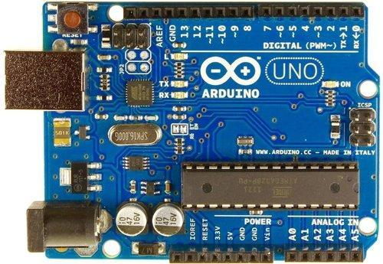
Project Submission: TOC (A6) CO-303 -Sourabh 2K18/CO/355 -Sunil Sahu 2K18/CO/363 Submitted to: -Mr. Rahul Kumar
Air QUALIT MONITORING using IOT

Slide 2
Air pollution has become a common phenomenon everywhere. Specially in the urban areas, air pollution is a real-life problem. A lot of people get sick only due to air pollution.
It is now important to monitor air pollution in real time in most of the urban areas. This project is aimed at developing an IOT device which can monitor air pollution in real time.
The air pollution monitoring device developed in this project is based Arduino UNO.
Introduction

Slide 3
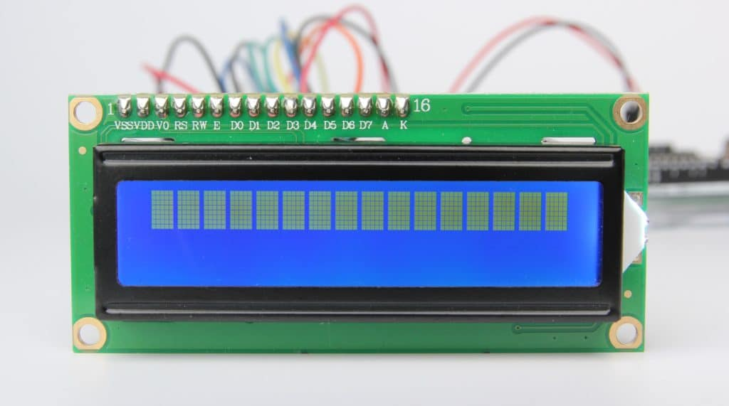
Arduino UNO – Arduino UNO is one of the most popular prototyping boards. The board comes with built-in Arduino boot loader. It is an Atmega 328 based controller board which has 14 GPIO pins, 6 PWM pins, 6 Analog inputs and on board UART, SPI and TWI interfaces. In this IOT device, 9 pins of the board are utilized.
Required Components
16X2 Character LCD – The 16X2 LCD display is used to monitor the sensor values read by the Arduino board. It is interfaced with the Arduino UNO by connecting its data pins D4 to D7 with pins 6 down to 3 of the controller respectively. The RS and E pins of the LCD are connected to pins 13 and 12 of the controller respectively.

Slide 4
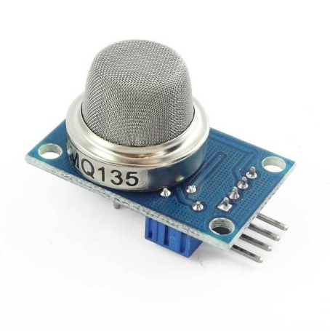
ESP8266 Wi-Fi Module – The ESP8266 Wi-Fi Module is
used to connect with any available internet hotspot
and transfer sensor data.
Required Components
MQ-135 Sensor –It is used to measure the concentration of
combustible gases. The sensor can detect the concentration of
combustible gases in range from 100 PPM to 1000 PPM.
Power Supply – The Arduino board and the Wi-Fi module require
3.3 V while LCD and MQ-135 sensor need 5V DC for their operation.
The Arduino can be powered by connecting it to a USB connection.

Slide 5
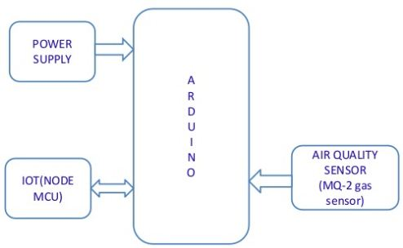
Initially all the connections are made, starting from plugging in the arduino board to the system using a USB cable. Further all the components mainly MQ135 sensor, LCD display and WiFi modules are connected.
The MQ135 sensor can sense NH3, NOx, alcohol, Benzene, smoke, CO2 and some other gases, so it is perfect gas sensor for our Air Quality Monitoring Project. When we will connect it to Arduino then it will sense the gases, and we will get the Pollution level in PPM (parts per million). MQ135 gas sensor gives the output in form of voltage levels and we need to convert it into PPM. So for converting the output in PPM, here we have used a library for MQ135 sensor.
.
Working

Slide 6
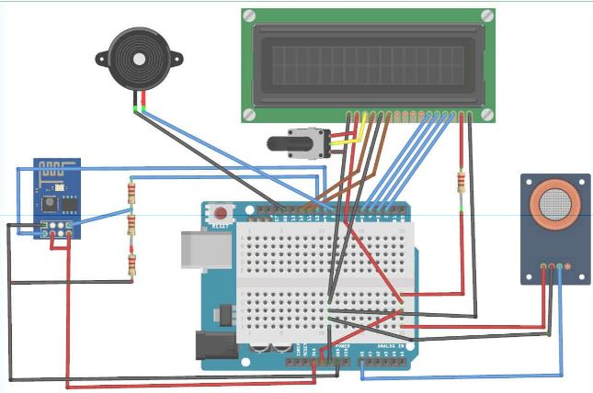
We need to first Calibrate the MQ135 Gas sensor. There are lots of calculations involved in converting the output of sensor into PPM value. So we have used a pre defined library which is available with the instruction module of the sensor.
Schematic Diagram
When the value will be less than 1000 PPM, then the LCD will display “Fresh Air”. Whenever the value will increase 1000 PPM, then and the will display “Poor Air, Open Windows”. If it will increase 2000 the LCD and webpage will display “Danger! Move to fresh Air”.

Slide 7
Once all the connections are made and the board is connected with the power supply through the system, pollution sensor starts to gather data. It generates output in the form of voltages.
These voltages are then converted into the ppm levels. After converting it into ppm levels and then from the system the values are displayed to the LCD screen.
Also we can track the process on the serial monitor (COM3)
Results and Output

Slide 8
ADVANTAGES
Sensors are easily available.
Detecting a wide range gases like CO2, CO etc.
Simple, compact and easily handle.
Continuous update of change in percentage of quality.
Advantages and Applications
APPLICATIONS
Roadside pollution monitoring.
Industrial perimeter monitoring.
Site selection for reference monitoring stations.
Indoor air quality monitoring.

Slide 9
Future scope
In future the project can be upgraded in more ways than one.
Interface more number of sensors to know gases present in air.
Design webpage and upload data on webpage.
Interface SDCARD to store data.
Interface GPS module to monitor the pollution.
Record the data for a long duration and analyze it with respect to time.
Future Scope

Slide 10
Conclusion
The system to monitor the air of environment using
arduino micro controller has been developed.
Gas sensor gives the sense of different type of dangerous gases.
It supports new technology and healthy life concept.
References
https://www.slideshare.net/LakshmanSaiPachigoll/iot-bazed-air-quality-monitoring-system
https://www.enginersgarage.com/contributions/arduino-based-air-quality-monitoring-iot-project/
Conclusion and References

